Slide 1

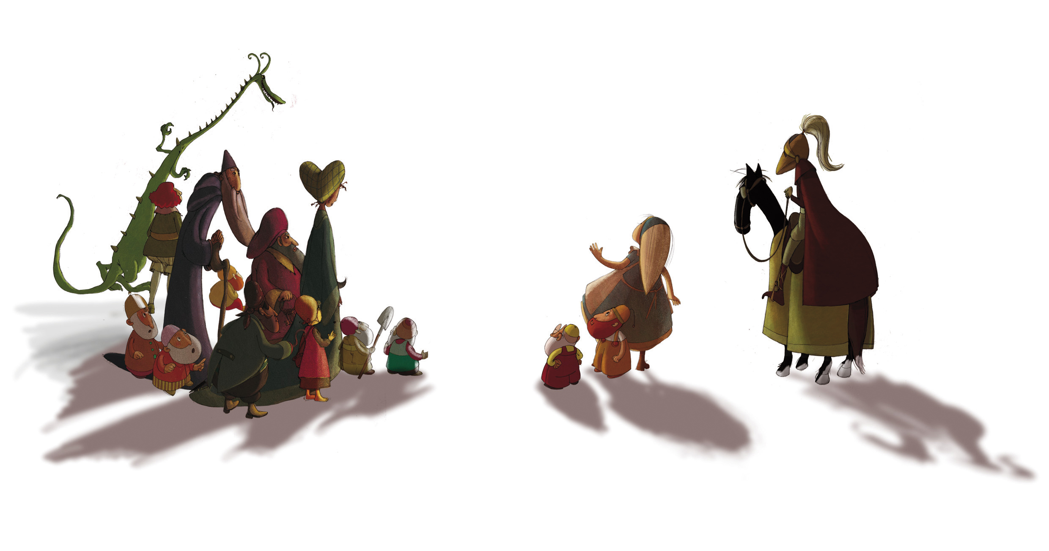
A presentation by Laurence Petit, Haut et court Distribution
Annecy juin 2010
A film by Dominique Monféry
Designed
by Rebecca Dautremer

Slide 2
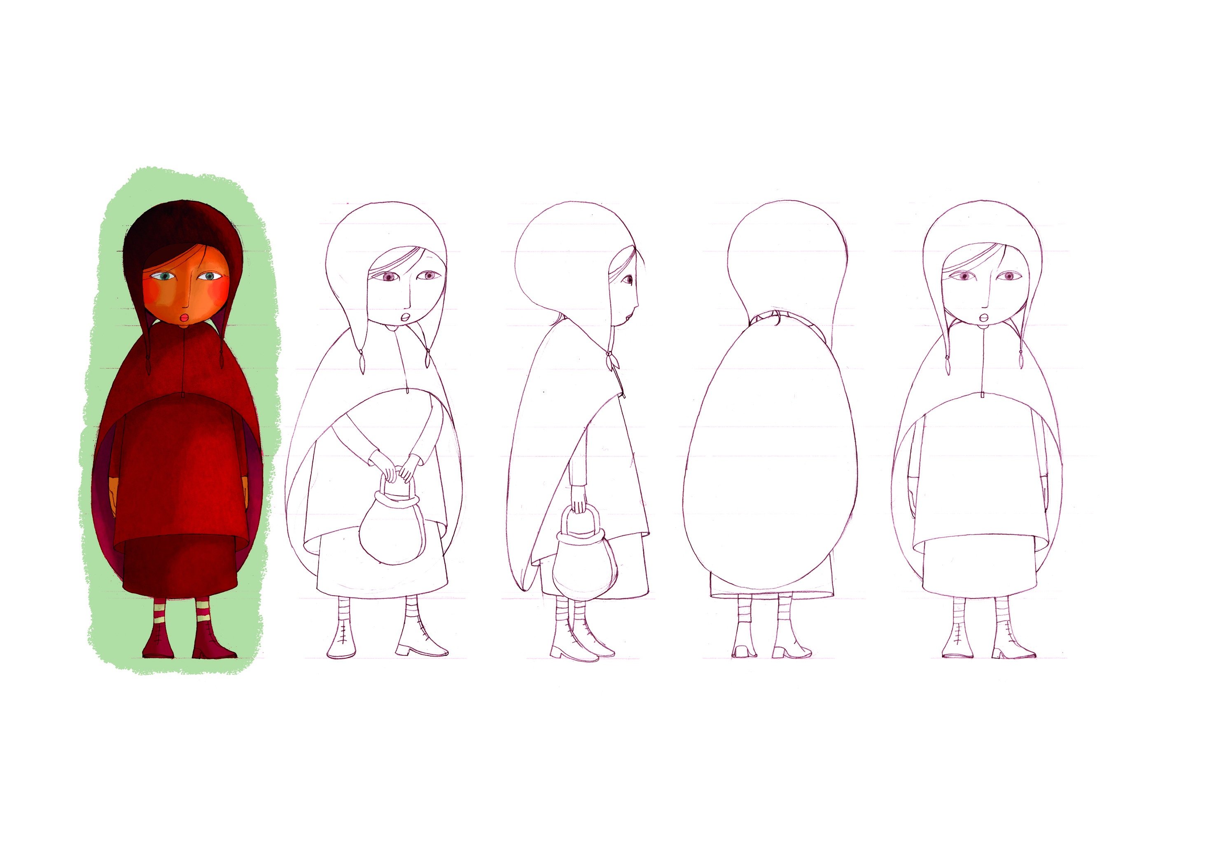

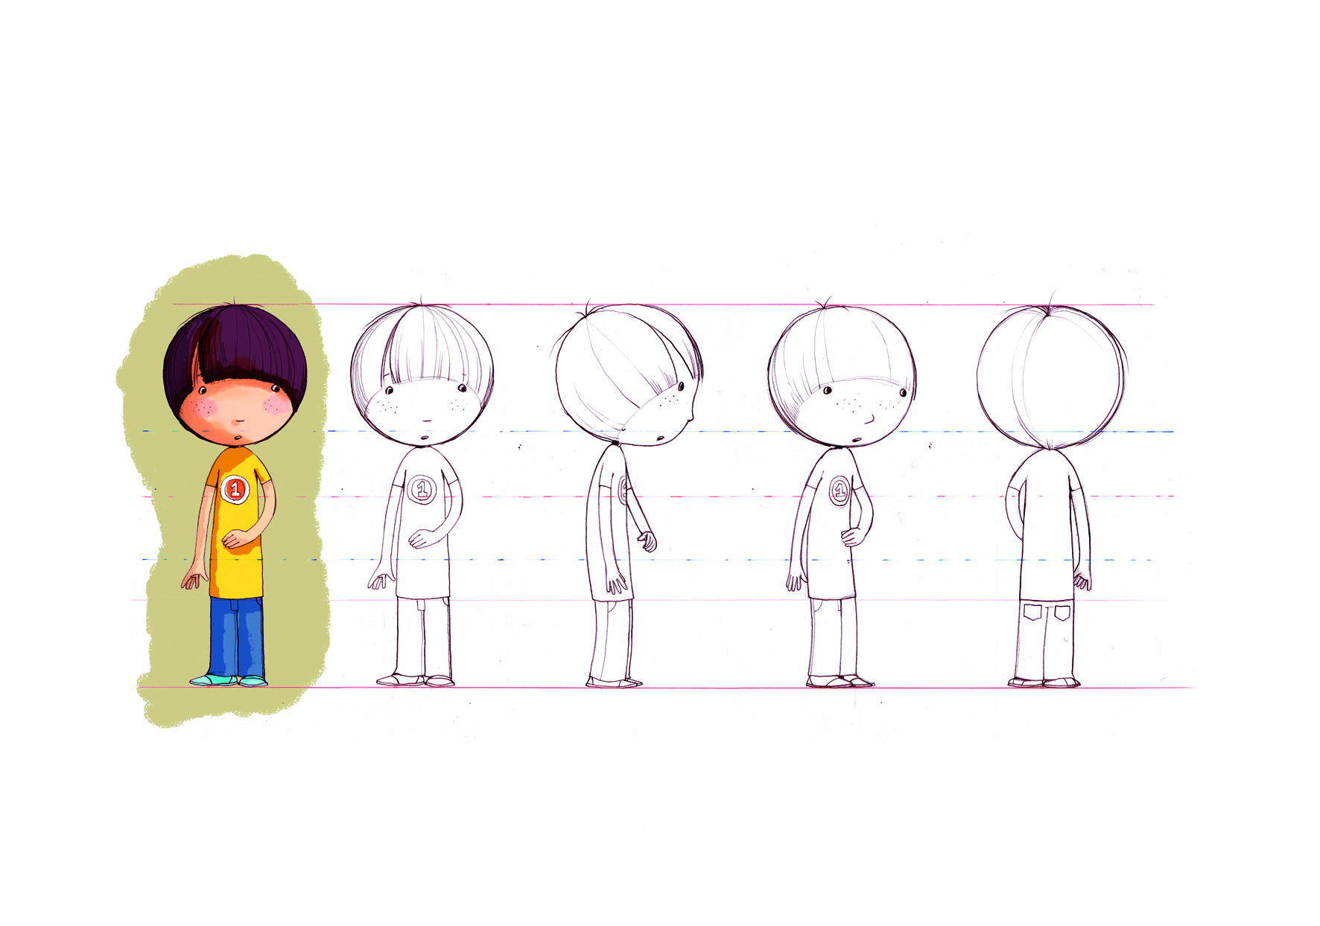
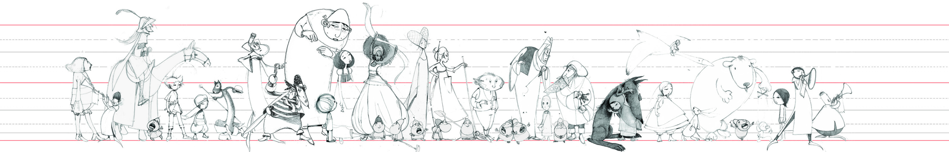
First Drawings

Slide 3
Acquisition
Bought in November 2008
At a very early stage
(script + a few drawings)
Only theatrical rights

Slide 4
Box office
Released on December 16th 2009
220 prints
500 000 admissions

Slide 5
Marketing strategy
Positioning statement
Target audience : 6 to 8 year-old children with parents prescription
Secondary audience : fan of Rebecca Dautremer work and books.

Slide 6
Release budget
Total of P&A (prints and advertising) :
600 000 euros
MG : 300 000 euros

Slide 7

Promotional material
We created and produced all the materials :
Teaser
Trailer
Poster

Slide 8
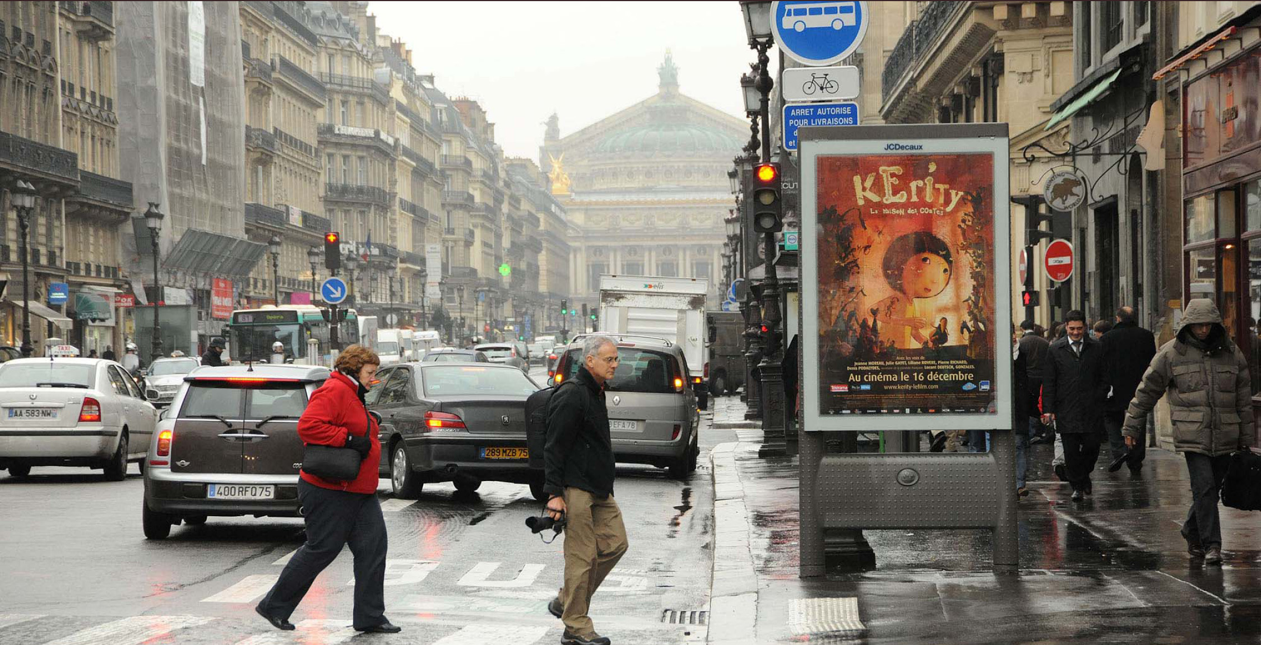
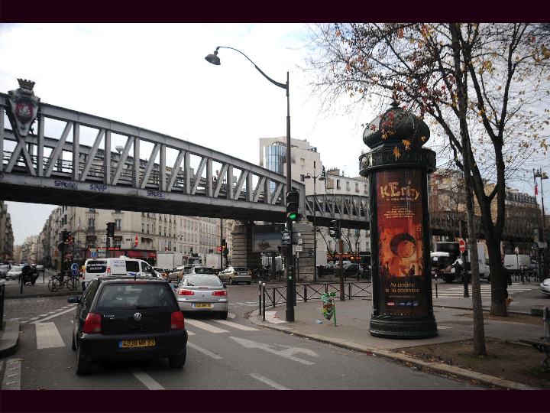
Poster campaign
December 8-15th
Paris
« mupi » JC Decaux
Colonne Morris

Slide 9

Original drawings

Slide 10
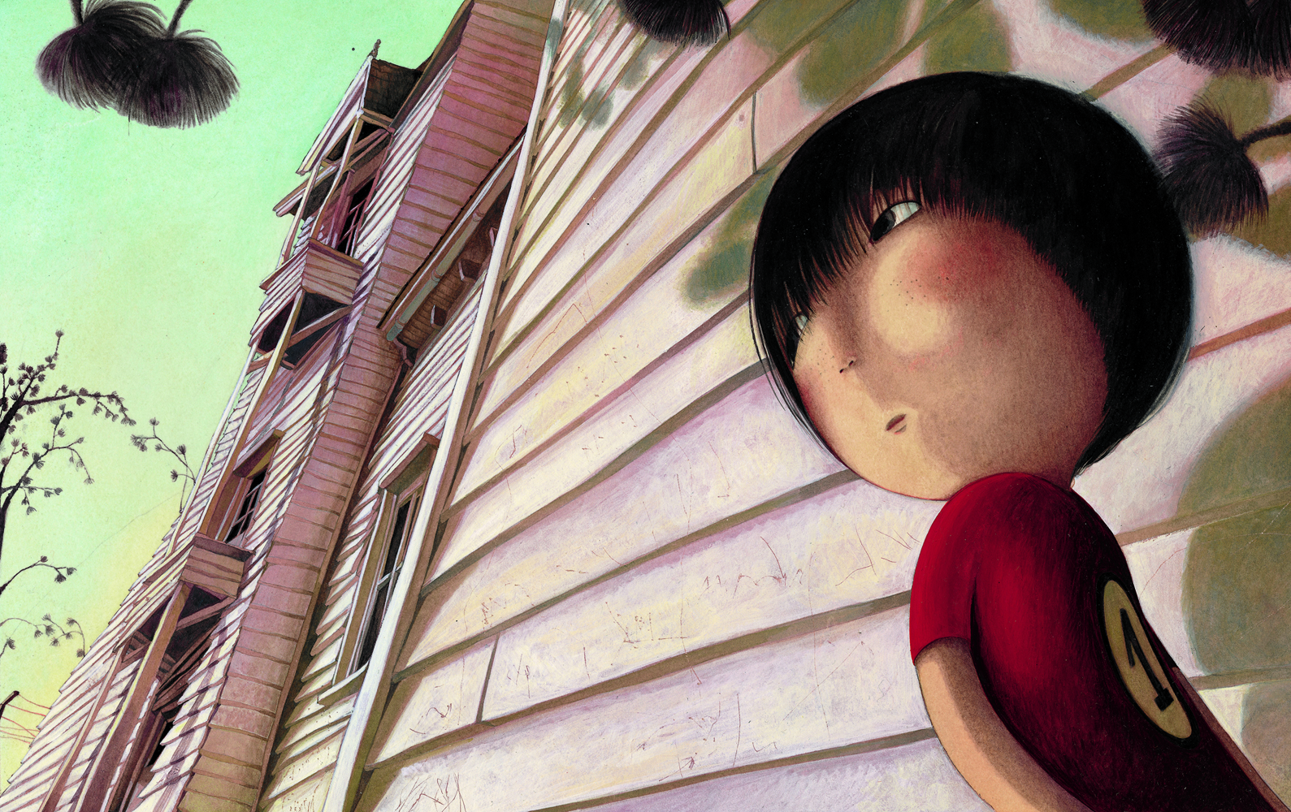
Original drawings

Slide 11
Casting
Jeanne Moreau
Julie Gayet
Pierre Richard
Denis Podalydès
Gonzales…

Slide 12
Broadcast
Rebecca interview :
TF1 –France 2 – France 3 – canal +
Julie Gayet – Jeanne Moreau :
Europe 1 – RTL – France Inter

Slide 13
Acclaimed unanimously by all the press supports !
« The Book illustrator Rebecca Dautremer enlightness with her magical pencil this amazing animated film. » Le Figaro
« Its magnificent ! »Télérama
« The most poetic film of Christmas. » Elle
« Absolutly necessary to gain knowledge, independance and dream… » Studio
« It’s of the films of the winter the most interesting one … » Première
« A cartoon as we love them ! » Marie-Claire

Slide 14
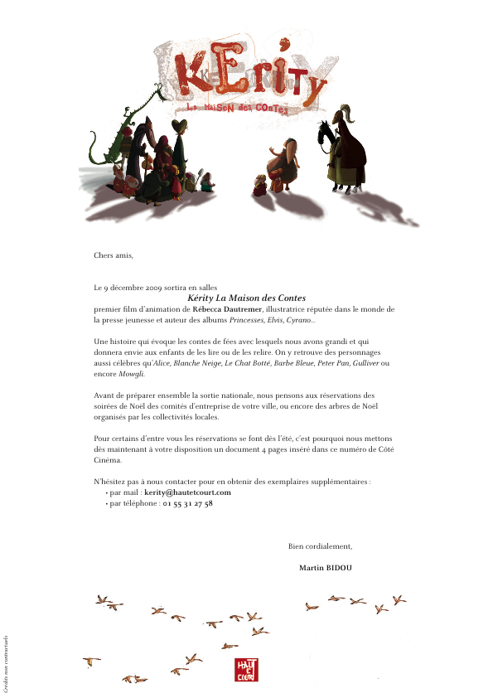
Attract Exhibitors
Production of an original Teaser
Mailing for the corporate
« Christmas trees »

Slide 15
Kérity Online
Official Website www.kerity-lefilm.com
designed by Supergazol
3 axes :
Professional
Edu-tainment
Dynamism & building audience loyalty

Slide 16
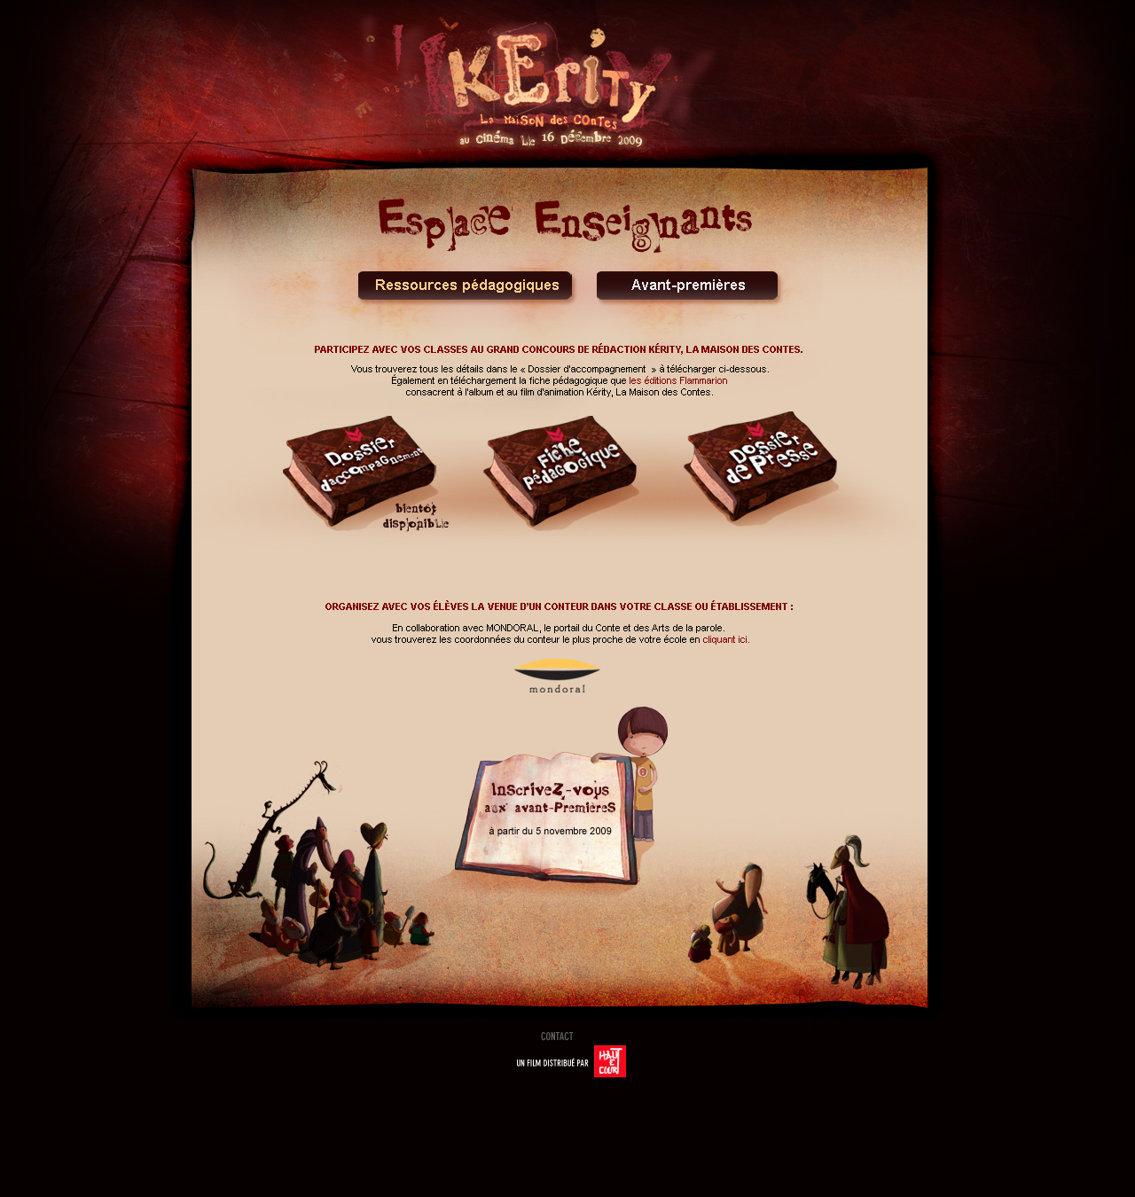
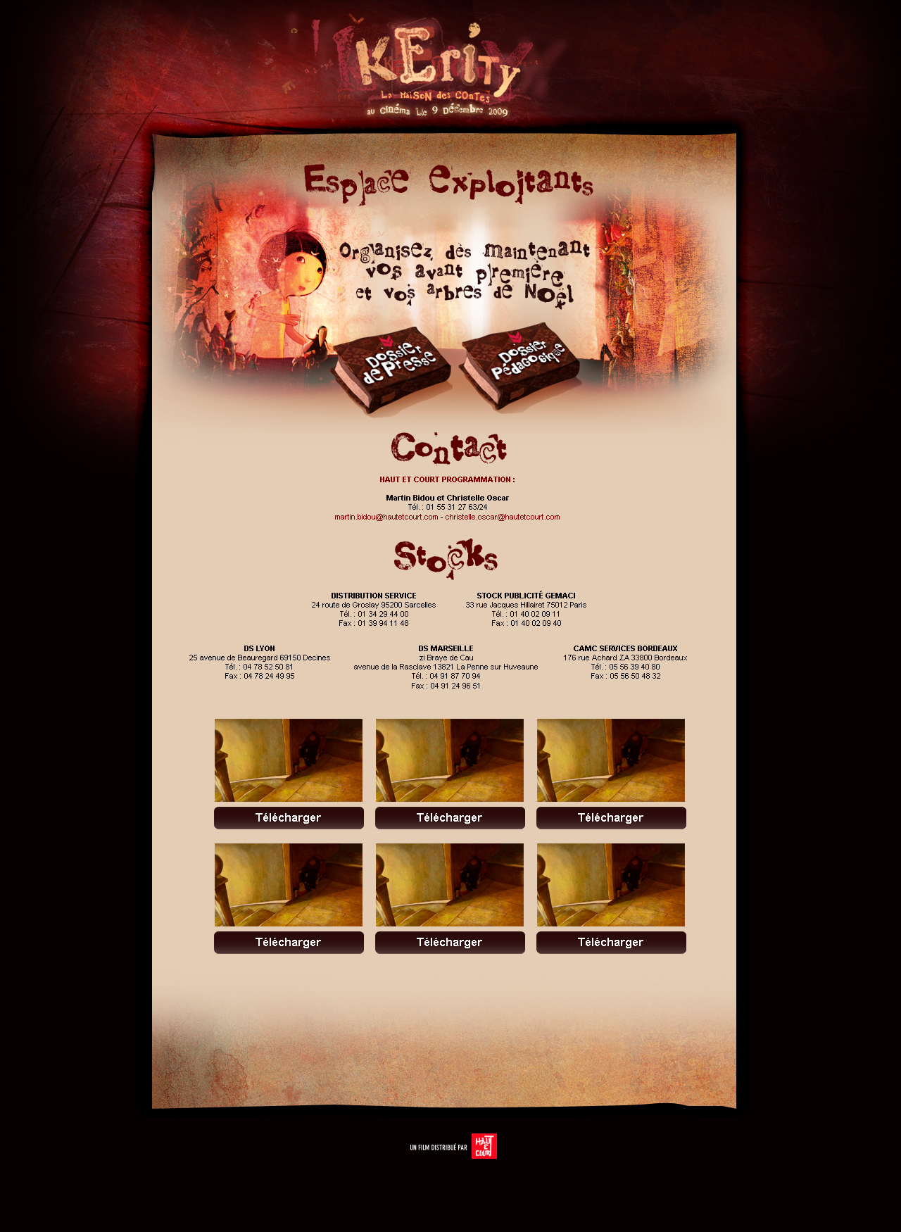

Slide 17





Media partners
Press : Télérama & ParisMômes
TV : TIJI
RADIO : France Bleu
Theaters network : AFCAE jeunesse

Slide 18

Academic partnership
Coordinated by Parenthèse Cinéma agency

Slide 19


Books

Slide 20
Exibitors
City screen
Arthouse sites
Multiplexes

Slide 21
Release
Released on 220 screens
arthouse theaters and multiplexes
Box office estimates : 500 000 admissions
Actual result : 500 000 admissions after 6 months
Final estimate : 600 000 admissions
DVD by Studio Canal released in April 2010

